Slide 1
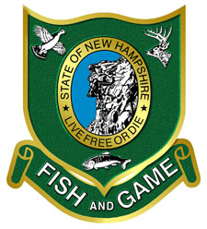
Natural Resource and Fisheries Issues Related to Offshore Wind Development
Cheri Patterson
Chief, Marine Fisheries, New Hampshire Fish and Game Department
Michelle Bachman
Analyst, New England Fishery Management Council

Slide 2
Natural resource conservation concerns
Concerns about placement of wind turbines and cables in sensitive habitat types (corals, hard bottom, vegetated habitats)
Both offshore (turbines, inter-array cables) and nearshore (export cable)
Concerns with not just fisheries being prosecuted but also all life stages.
Construction and operational noise impacts on fishes, invertebrates, and marine mammals
Potential effects of electromagnetic fields on electrically sensitive species (lobsters, sharks, skates)
Artificial reef effects of turbines, and associated ecological effects
Habitat conversion from soft to hard bottom due to scour protection
Changes to wind fields and oceanographic conditions

Slide 3
Impacts to natural resource surveys
Placement of wind turbines will preclude or alter existing surveys, e.g.
State and federal bottom trawl (e.g., federal bottom trawl (spring and fall), sea scallop, Atlantic shrimp, Atlantic surfclam/ocean quahog; ME/NH and MA inshore trawl - spring and fall.)
Protected resource surveys
These provide key data inputs for stock assessments and management
May affect catch limits, and thus fisheries
Will need to develop new and modified approaches based on different technologies, using different gear types/vessels
Mitigation expected to be expensive

Slide 4
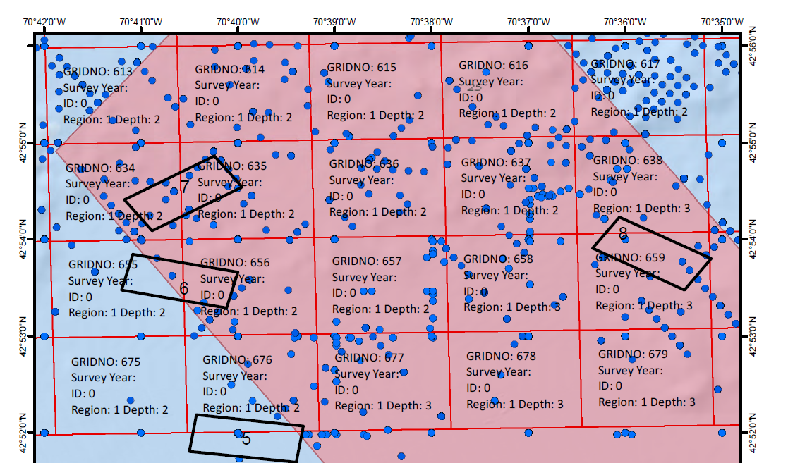
ME/NH Inshore Survey grid pattern

Slide 5
Regional science initiatives
What are the key questions, and how can we answer them?
Importance of coordinating and standardizing design and data elements between developer, state, and federal surveys
How can we share data with each other?
Many individuals and organizations are working on this
ROSA (Responsible Offshore Science Alliance) – fishery species; https://www.rosascience.org/
RWSE (Regional Wildlife Science Entity) – wildlife and protected species; https://www.nyetwg.com/regional-wildlife-science-entity
Northeast Regional Ocean Council – Seafloor Habitat Data Work Group; https://www.northeastoceancouncil.org/committees/ocean-planning/
Importance of adaptive science and management - best practices will evolve with time – some questions will be answered, and others will emerge

Slide 6
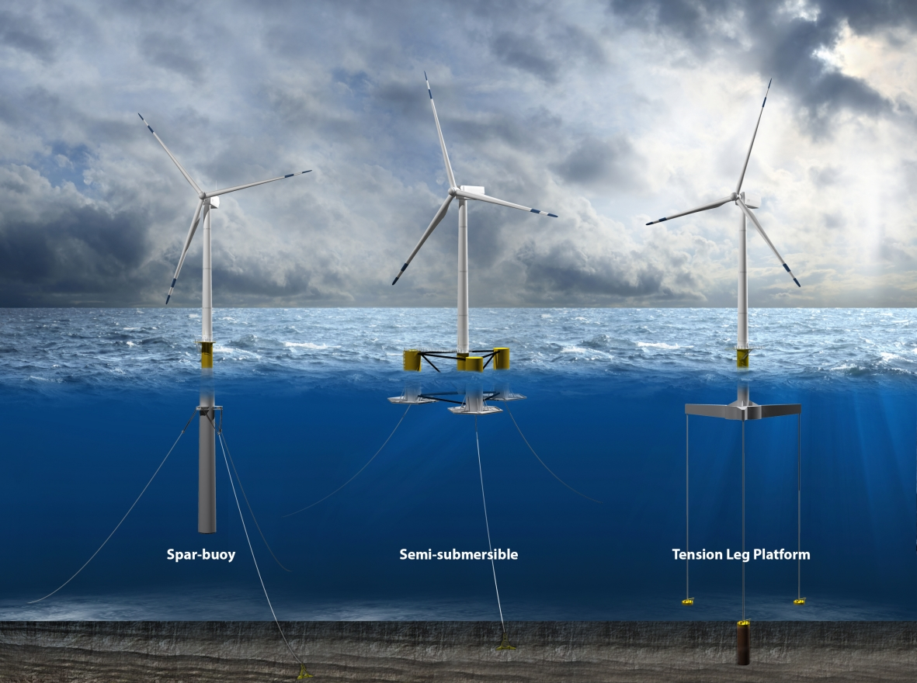
Fishery operational concerns
Reduced ability of fishing vessels to operate in wind farms depending on location and spacing of turbines
Could affect both fishing and transit
Likely differences between fixed and floating arrays
Potential for interaction with export and inter-array cables
Issue for trawls and dredges if cables cannot be buried due to seafloor conditions
Safety and radar issues
Possibility of allision with turbines, especially in poor weather
Concerns about radar shadowing
Implications for search and rescue
Recreational fishing opportunities
Artificial reef effect
Are wind turbines a positive or negative?

Slide 7
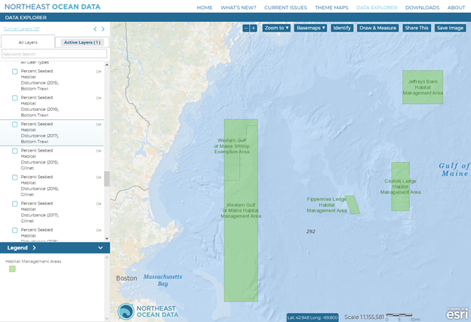
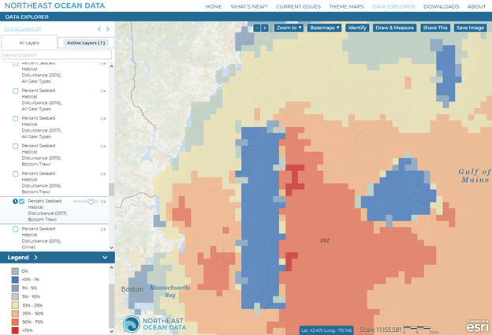
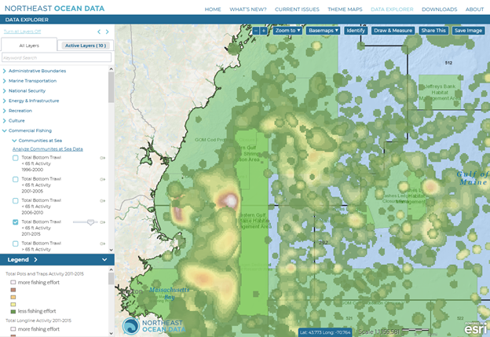
Habitat Management Areas
% seabed disturbance bottom trawl
Small picture of fishing footprint in GOM

Slide 8
Fishery dependent data
Importance of carefully investigating existing fishery uses during siting
Be cautious of data gaps
Private recreational angling is a data gap, generally.
Many questions
Which fisheries, communities will be affected?
If a wind farm displaces fishing activity, where is effort likely to move to?
NOAA Fisheries tool for evaluating socioeconomic impacts on federally-managed commercial fishing (fishing footprint)
https://www.fisheries.noaa.gov/resource/data/socioeconomic-impacts-atlantic-offshore-wind-development
Will add for-hire party and charter recreational fishing data soon

Slide 10
Fishing industry outreach and advocacy
Importance of early and often engagement with harvesters
Many projects, many meetings
Role of fisheries liaisons and fisheries representatives at the developer level
RODA (Responsible Offshore Development Alliance)
Commercial fisheries, mostly east coast but expanding
Advocacy related to transit and operations, science, permitting and environmental review processes
Includes some membership and leadership from Gulf of Maine
https://rodafisheries.org/

Slide 11
NOAA Fisheries and offshore wind
NOAA Fisheries involved in environmental review process as a cooperating agency with BOEM
This includes diverse responsibilities, but one specific role is conducting the Essential Fish Habitat consultation
What are the impacts of a proposed project on habitat?
How can they be minimized or mitigated?
More information about habitat consultations https://s3.amazonaws.com/nefmc.org/3-EFH-Consults-and-Habitat-Assess-for-Offshore-Wind.pdf
Provide expertise related to fisheries and protected resource issues as well
Multiple simultaneous projects, challenging workload and timelines

