Slide 1
Commission to Study Offshore Wind & Port Development
March 23,2021

Slide 2
Mission
Our purpose is to provide residents with affordable, accessible education and training that aligns with the needs of New Hampshire’s businesses and communities, delivered through an innovative, efficient and collaborative system of colleges. CCSNH is dedicated to the educational, professional and personal success of its students; a skilled workforce for our state’s businesses; and a strong New Hampshire economy.
Vision
To maintain New Hampshire’s positive economic indicators, including low unemployment and high per capita income, NH will need 65 percent of adults with education beyond high school. CCSNH is committed to achieving this vision by 2025.

Slide 3
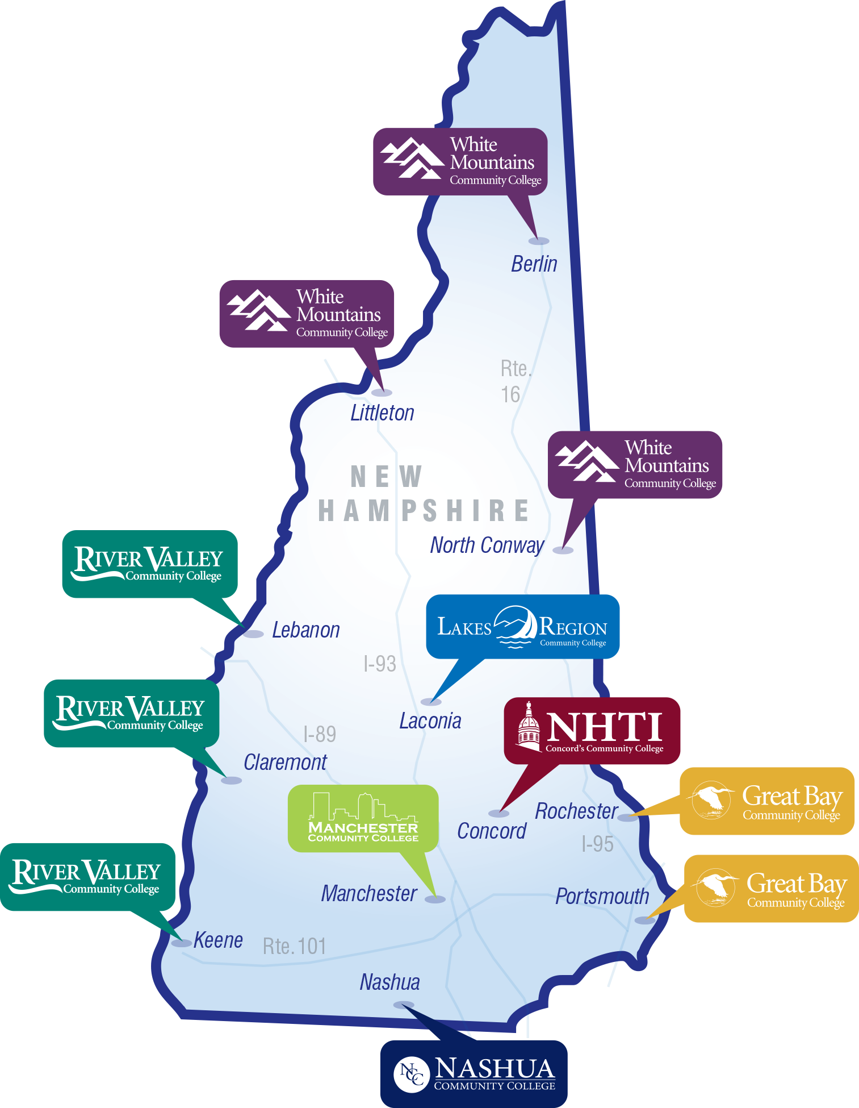
CCSNH supports a resilient and evolving economy
Campuses in every region of NH – local partnerships to assess/meet regional needs serve local populations
Student success. 95% of our students are NH residents – on educational & career pathways that include:
Associate degrees & certificates
Workforce training in partnership with employers, apprenticeships & bootcamps
Strong connections to high schools/CTE including low-cost dual-credit (Running Start/Early College)
Programs designed for transfer to USNH (and others)
Mission requires agility to meet needs as they emerge
Programming and delivery strategies designed to meet NH’s needs

Slide 4
Great Bay Community College History
1945: Founded as a State Trade School
2005: Chartered as an Independent College
2008: Comprehensive Community College
Today: Seven independent within a coordinated system across all of NH.
Workforce Development and education leading directly to careers is and will always be part of our DNA.
Each college has WFD resources and beginning in 2021 CCSNH is adding a Director of WFD position
CCSNH – USN Education Partnership Agreement(2020) (GB/PNS 20 year relationships)

Slide 5
ApprenticeshipNH
Funded by grants from U.S. Department of Labor beginning in 2016
Focus on helping employers in 5 key industries – Advanced Manufacturing, Healthcare, IT, Hospitality, Construction and Infrastructure
Assist business in developing Registered Apprenticeship (RA) program
Create sustainable system for RA in NH
Connecting job seekers to apprenticeship career pathways
Notes:
Anne
Apprenticeship – 5 components, DOL Office of Apprenticeship

Slide 6
ApprenticeshipNH and AACC
Additional Apprenticeship Funding through AACC in 2019
Focus on assisting employers in 3 key industries – Auto, Biotechnology, and Healthcare
Works alongside original DoL grant to leverage resources
Notes:
Anne
Apprenticeship – 5 components, DOL Office of Apprenticeship

Slide 7
Youth Apprenticeship (separate grant) - 2020
Pre-Apprenticeship and additional Apprenticeship Funding beginning at age 16.
Works alongside original DoL grant to leverage resources
Notes:
Anne
Apprenticeship – 5 components, DOL Office of Apprenticeship

Slide 8
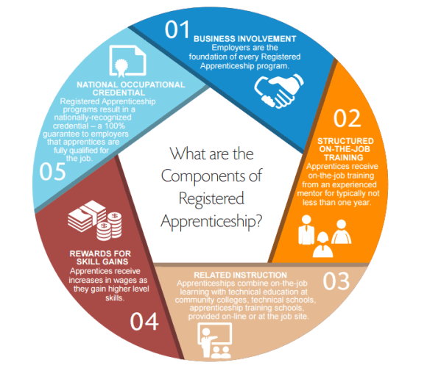
Earn While you Learn Model
Key Components of Registered Apprenticeship
Employer driven
Structured on-the-job learning
Classroom education
Progressive wages
National industry certificate

Slide 9
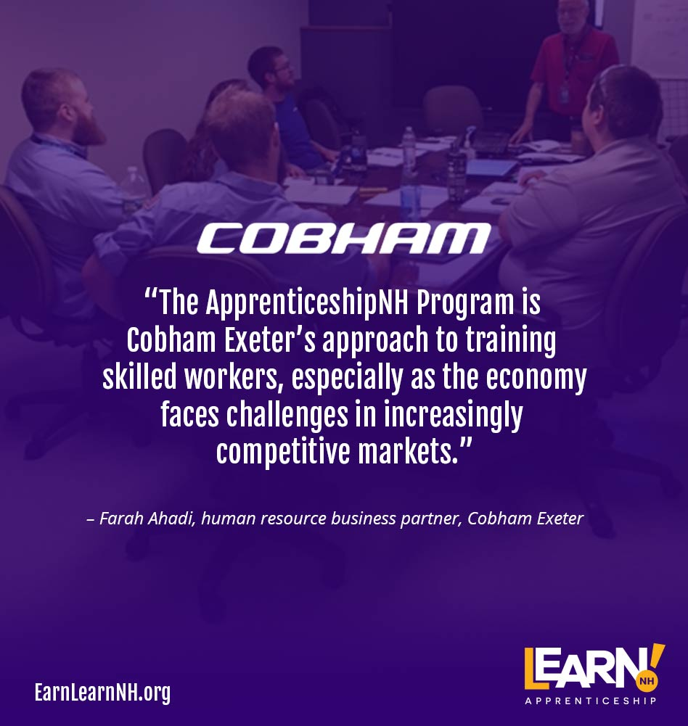
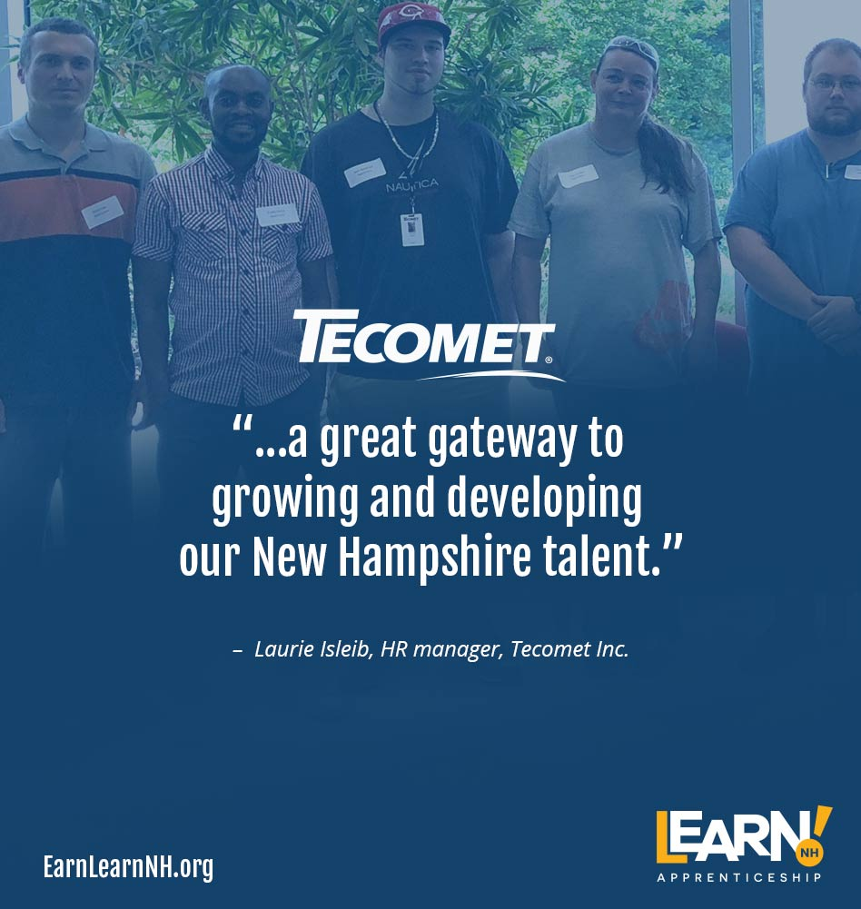
What Employers are Saying:
Notes:
Anne

