Slide 1
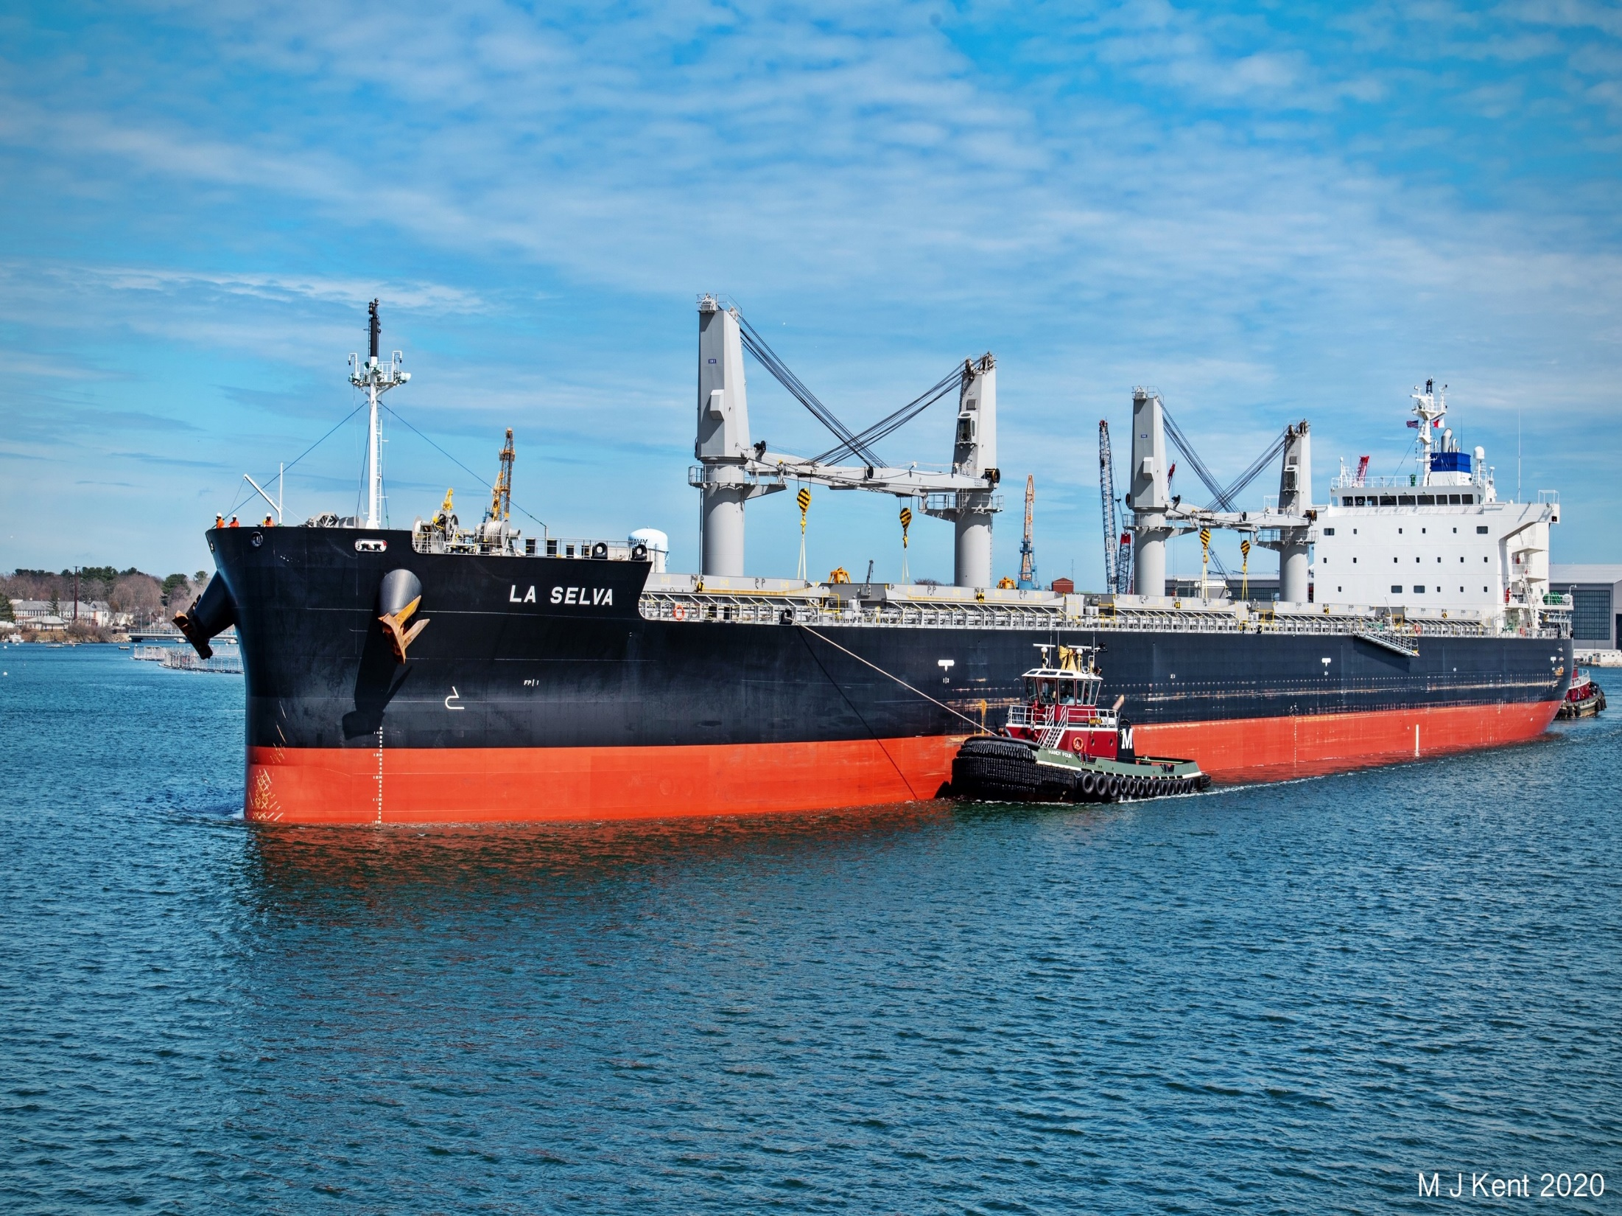
PEASE DEVELOPMENT AUTHORITY
DIVISION OF PORTS AND HARBORS
The management, maintenance, operation and maritime security of:
The state owned, deep water, public access, general cargo marine terminal
Passenger/ferry, commercial fishing and recreational vessel facilities in Portsmouth, Rye and Hampton Harbors
Permitting of moorings and placement of aids to navigation in tidal waters
Licensing of harbor, river and docking pilots
Maintaining and dredging channels, harbors and anchorages
Establishing and maintaining Foreign-Trade Zones in New Hampshire
Management of a Revolving Loan Fund for commercial fishermen

Slide 2
PISCATAQUA RIVER TERMINALS
*From U.S. Army Corps of Engineers

Slide 3
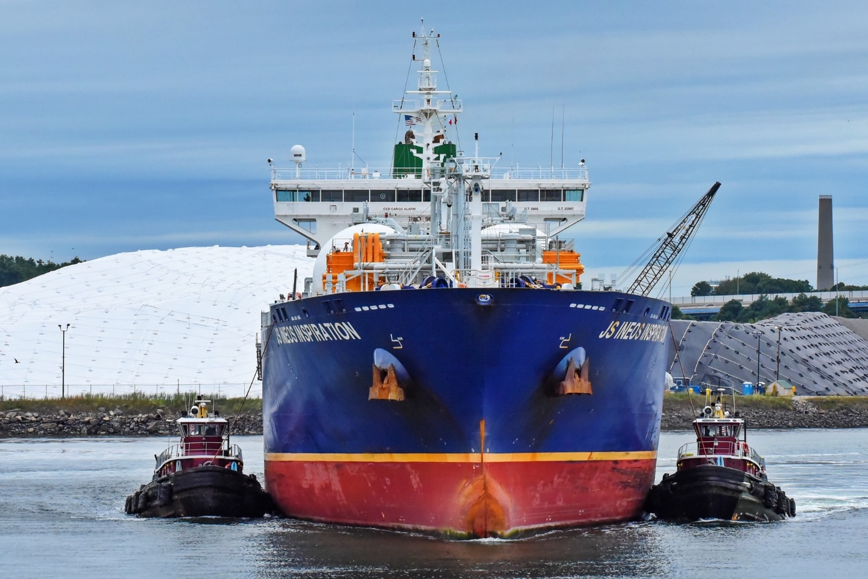
PILOTAGE
A pilot is a licensed Merchant Mariner, who by qualification and experience, is licensed by the US Coast Guard to act as a pilot (guide) aboard vessels transiting local waters designated as the “Pilotage Area”
A State Pilot License, issued by the Division, is also required to act as a Pilot in Portsmouth Harbor and the Piscataqua River

Slide 4
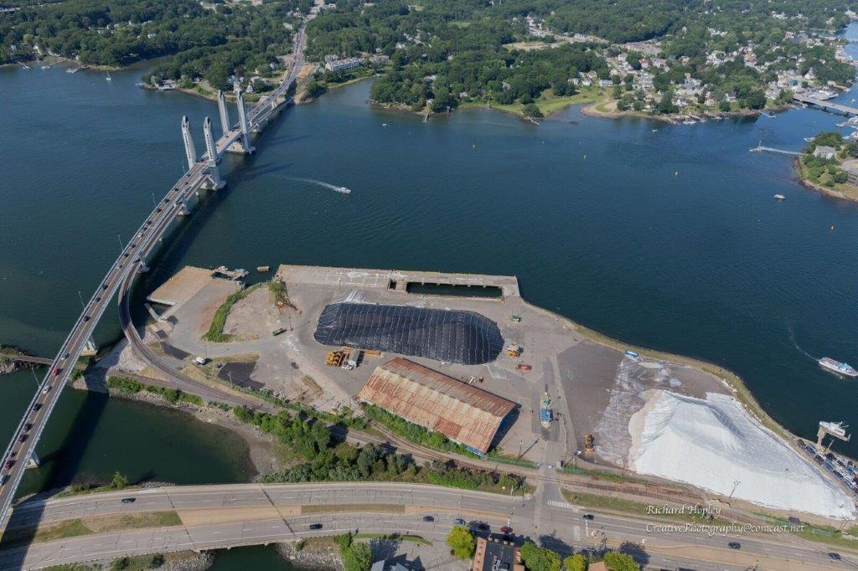
MARKET STREET MARINE TERMINAL
State Owned
Deep Water
General Cargo
General Use
Public Access
Ice Free

Slide 5
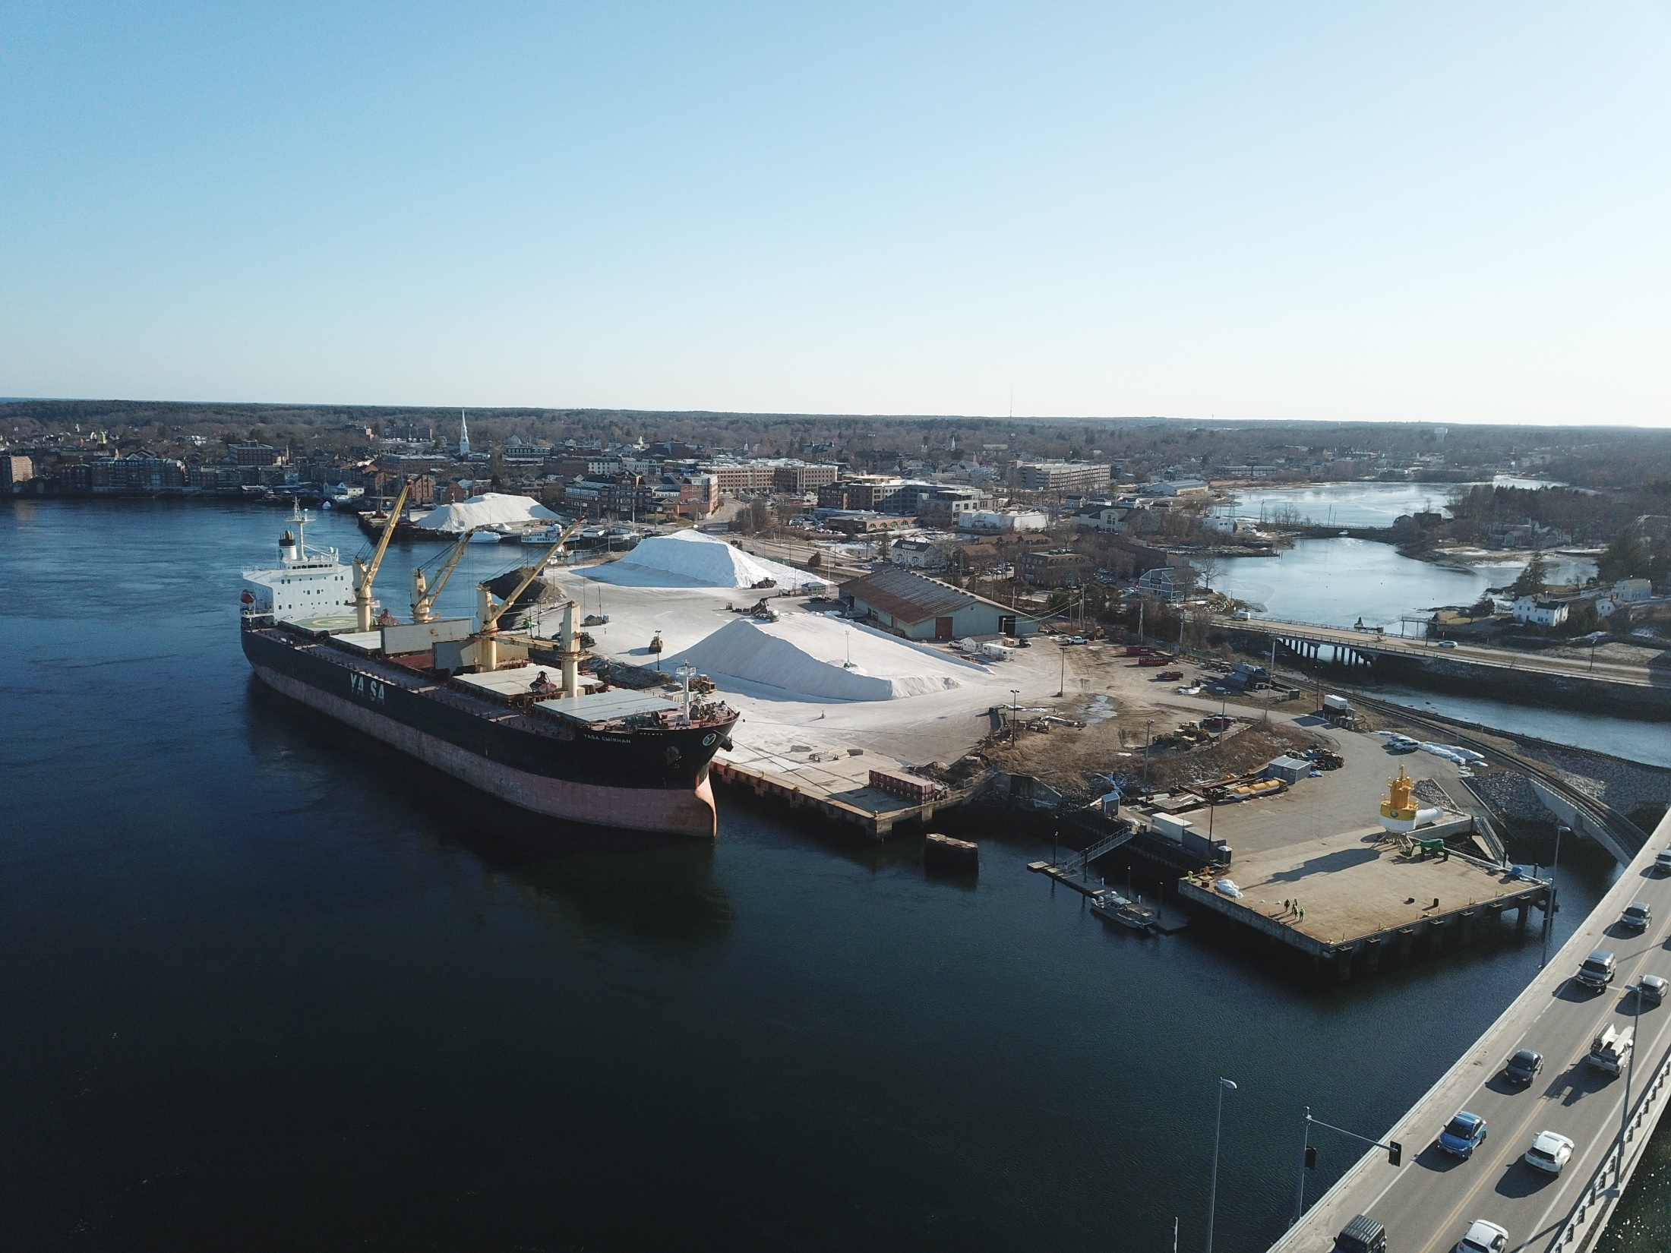
BULK CARGO
Morton Salt
Eastern Minerals
FY 2020 – 454,885 Tons Road Salt

Slide 6
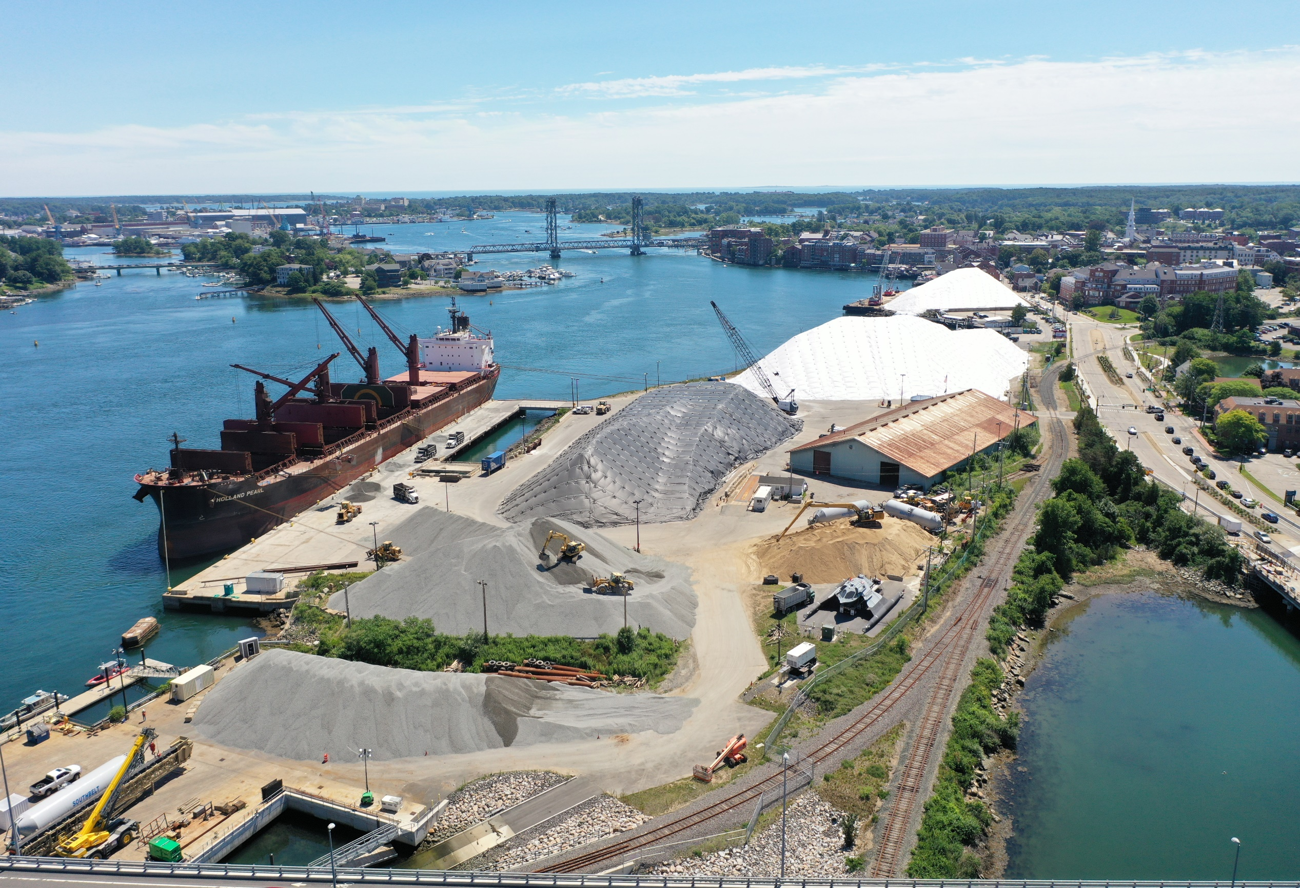
CONSTRUCTION SUPPORT
PORTSMOUTH NAVAL SHIPYARD
Concrete Materials
Aggregate
Sand
Cement
Fly Ash

Slide 7
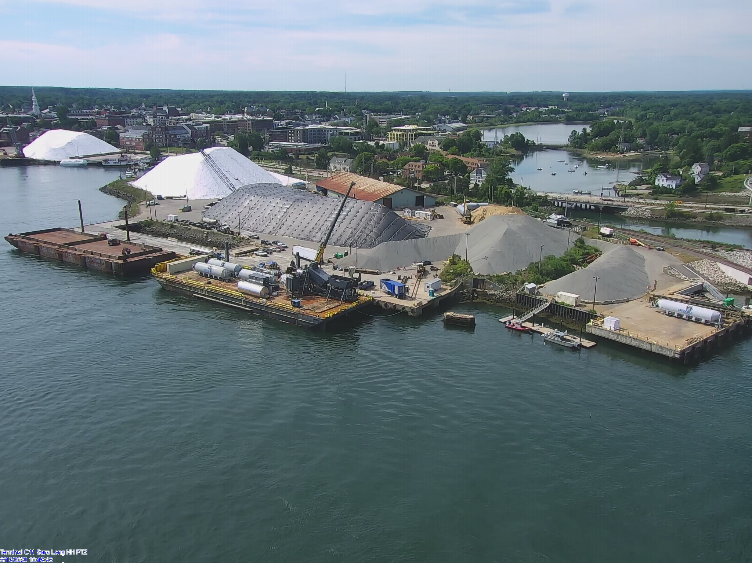
CONSTRUCTION SUPPORT
PORTSMOUTH NAVAL SHIPYARD
Equipment Assembly
Material Transport

Slide 8
PROJECT CARGO VIDEO

Slide 9
PROJECT CARGO
Wind Turbine Blades

Slide 10
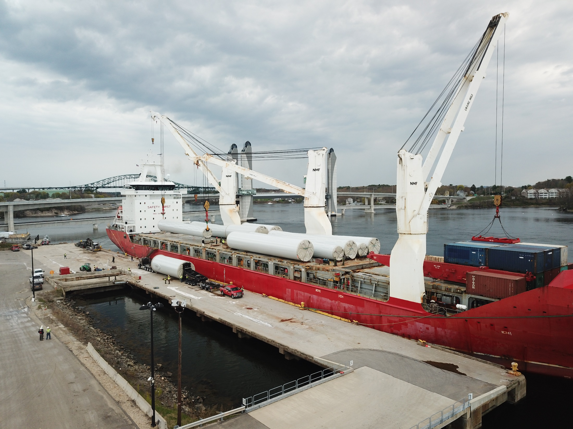
PROJECT CARGO
Wind Turbines
Towers
Nacelles

Slide 11
TRANSPORTING TOWER SECTIONS video

Slide 12
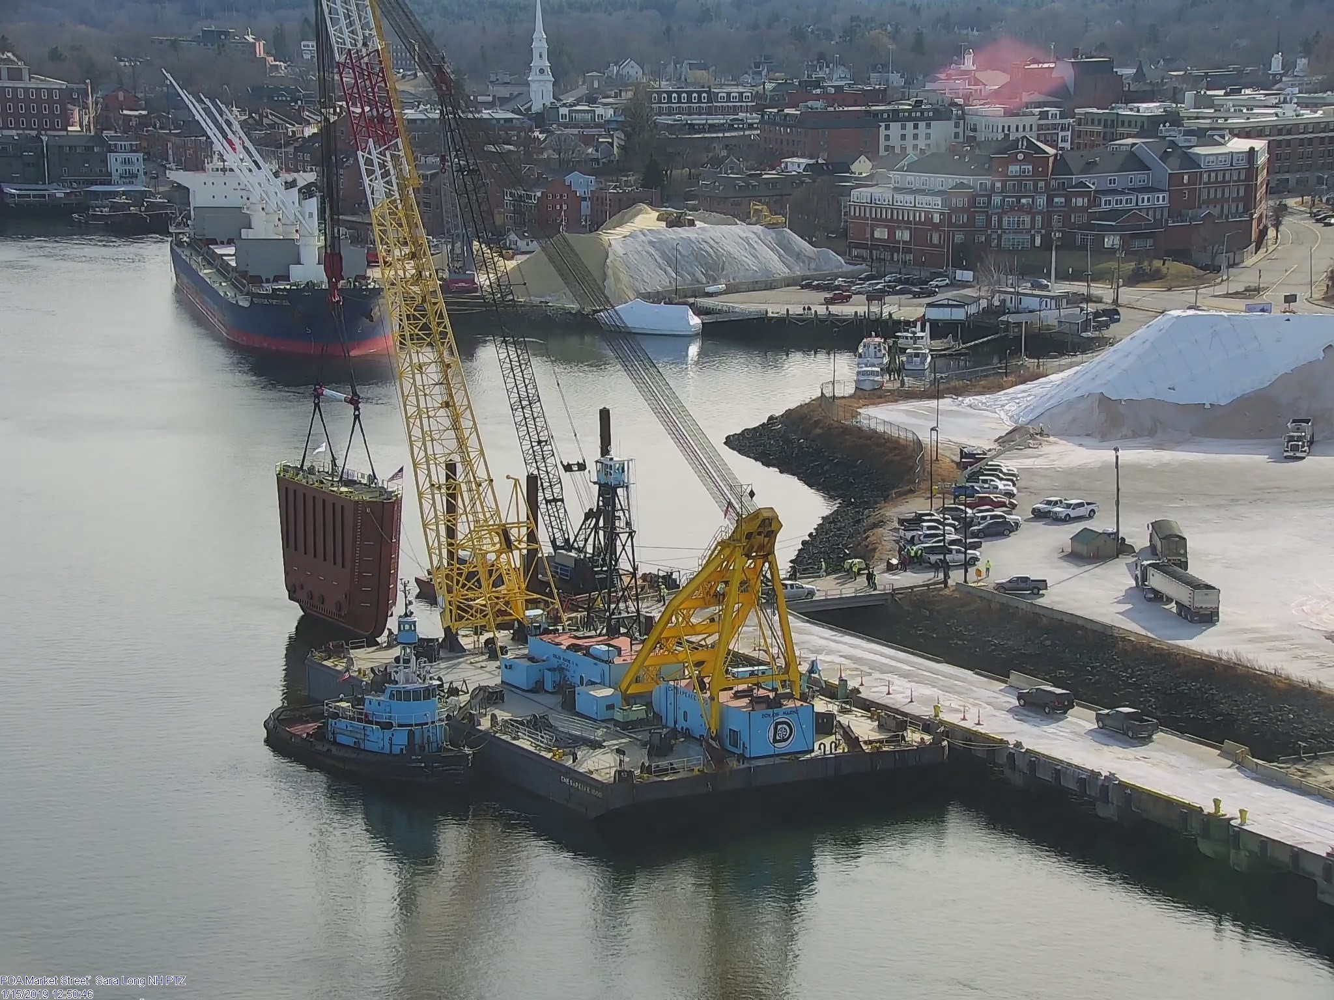
PROJECT CARGO
HEAVY LIFT
Dry Dock Gate
PNSY

Slide 13
PROJECT CARGO
HEAVY LIFT
Power Plant Components
Westinghouse Nuclear Div.

Slide 14
#1 FUNCTIONAL REPLACEMENT
FHWA & NHDOT

Slide 15
#2 REHABILITAION & MODIFICATION
USDOT BUILD GRANT

Slide 16
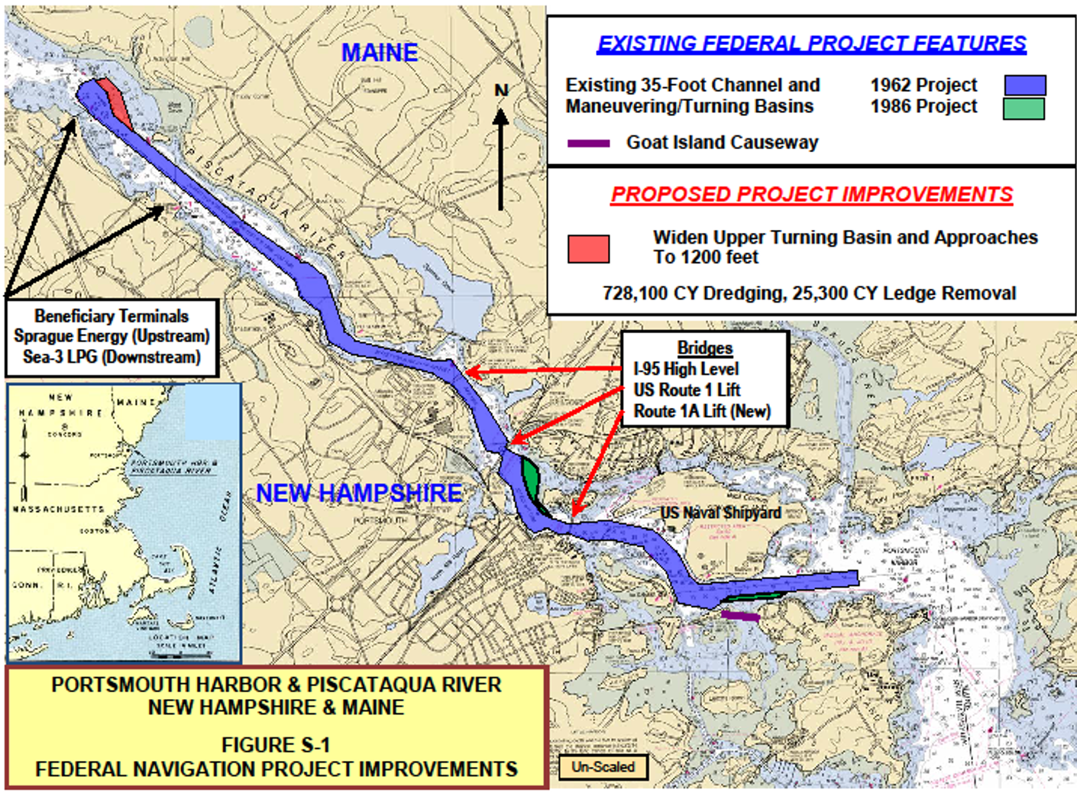
#3 TURNING BASIN EXPANSION
US ARMY CORPS

Slide 17
DIVISION OF PORTS AND HARBORS Plan for the Maintenance and Development of the Ports and Tidal Waters Aid in the Development of Salt Water Fisheries Foster and Stimulate Commerce and the Shipment of Freight through the State’s Ports RSA 12-G
www.portofnh.org
Captain Geno Marconi, Director

