Slide 1
Northeast Offshore Wind Procurement: Lessons for New Hampshire
December 21, 2020
NH Senate Commission to Study Offshore Wind and Port Development

Slide 2
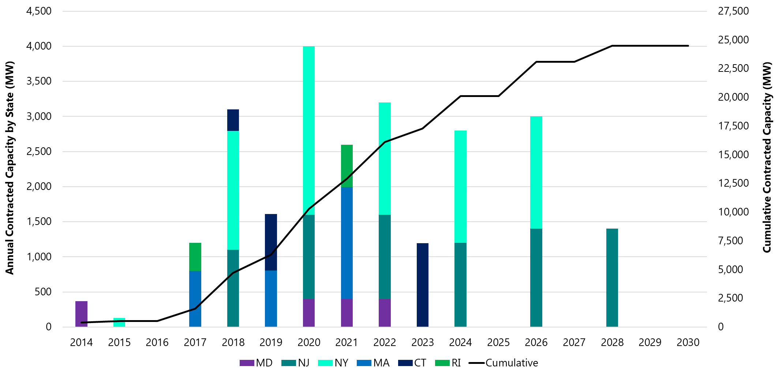
US OSW Procurement by Solicitation Year
Northeast OSW Procurement
Doesn’t include Virginia plans for 5.2GW of offshore wind by January 1, 2034 given not to be competitively procured

Slide 3
Factors Driving Support for Offshore Wind (OSW)
Northeast OSW Procurement
Manner in which these factors considered determined by legislation or policy direction
Power Supply Benefits
Consumers
Policymakers
Economic Development Benefits
Workers / Businesses
Environmental Benefits
Society

Slide 4
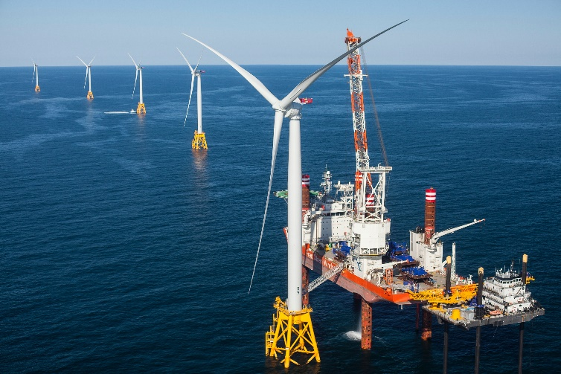
OSW Projects Require Major Investment
Northeast OSW Procurement
OSW developers require revenue certainty to support project investments
Significant benefit of projects are environmental benefits from displacement of fossil fuels
Renewable energy certificates (RECs) used to monetize value of renewable energy
Long-term power purchase agreements where local utility purchases the energy and RECs produced provide OSW developers with needed revenue certainty
This structure used to support renewable project development throughout the Northeast

Slide 5
State OSW Procurement Goals
Northeast OSW Procurement
State | Goal (MW) | Prevailing Statute/Enabling Policy
Massachusetts | 3,200 by 2030 | Act to Promote Energy Diversity, Chapter 188 of the Acts of 2016 An Act to Advance Clean Energy, Chapter 227 of the Acts of 2018 (requiring 2019 DOER Offshore Wind Study)
Connecticut | 2,300 by 2030 | An Act Concerning the Procurement of Energy Derived from Offshore Wind, 2019 (HB 7156), Public Act 19-71
Rhode Island | n/a (430 MW procured + 600 MW planned) | Executive Order 20-01
New York | 9,000 by 2035 | Climate Leadership and Community Protection Act, 2019 (S6599/A8429)
New Jersey | 7,500 by 2030 | Executive Order #92
Maryland | 1,580 by 2027 | Offshore Wind Energy Act, 2013 Clean Energy Jobs Act, 2019
Virginia | 5,200 by 2034 | The Virginia Clean Economy Act, 2020 (HB 1526/SB 851)

Slide 6
Thoughts for New Hampshire OSW Procurement
Northeast OSW Procurement
What are NH’s objectives and how should they be conveyed?
Timing
Project location
Cost-effectiveness
Economic Development
Fit with other state’s procurements
Larger OSW projects offer economies of scale and lower costs
Yet, must fit with New Hampshire procurements needs
Reasonable proportion of power supply portfolio
Project risk mitigation from multiple contracts

Slide 7
John Dalton
President, Power Advisory LLC
jdalton@poweradvisoryllc.com

